Slide 1

CVR COLLEGE OF ENGINEERING DEPARTMENT OF COMPUTER SCIENCE AND ENGINEERING
A Project Seminar-I
on
Crypto Exchange App
by
M. Ritvik Reddy(20B81A05M2)
P. Sowmith Reddy (20B81A05P0)
V. Sujith Reddy(20PQ1A0567)
Under guidance of
Mr. Syed Muqthadar Ali
Sr.Assistant Professor

Slide 2
ABSTRACT
A cryptocurrency exchange app that uses swapping of two different valued tokens named EVT and DVT, and how it is implemented using Flutter frontend, Infura for smart contract integration, and Solidity for writing smart contracts.The cryptocurrency exchange app is designed to provide users with the ability to trade or swap tokens on the Ethereum blockchain. In this app, two tokens are supported: EVT and DVT. EVT and DVT are ERC-20 tokens, which means they are built on the Ethereum blockchain and follow the ERC-20 standard for token implementation.
The frontend of the app is developed using Flutter, a popular cross-platform framework for building mobile applications. Flutter allows for the creation of a seamless user interface that enables users to interact with the app's functionalities easily. The app's frontend communicates with the Ethereum blockchain using Infura.
Infura is a service that provides access to the Ethereum network without the need for users to run their own Ethereum node. It acts as a bridge between the app's frontend and the Ethereum blockchain. By connecting to Infura , the app can interact with the smart contracts deployed on the Ethereum network.
The smart contracts that power the swapping functionality of the app are written in Solidity. Solidity is a programming language specifically designed for writing smart contracts on the Ethereum platform. The smart contracts define the rules and logic for token swapping, including price calculation, token balances, and transfer functions

Slide 3
MOTIVATION
Smart Contracts for Trust and Security: Solidity, as the chosen programming language for writing smart contracts, ensures that the rules and logic governing token swapping are secure and transparent. Smart contracts executed on the Ethereum blockchain provide a trustless environment, enhancing the security of transactions and reducing the need for users to rely on centralized authorities.
Decentralized Exchange (DEX) Benefits: The swapping functionality offered by the app aligns with the principles of decentralized exchanges (DEX). By allowing users to swap EVT and DVT tokens directly on the Ethereum blockchain, you contribute to the decentralization of the cryptocurrency market, providing users with more control over their assets without the need for intermediaries.
Educational Impact: Developing a cryptocurrency exchange app using cutting-edge technologies such as Flutter, Infura, and Solidity offers an opportunity for education and skill development. By contributing to the understanding and adoption of blockchain technologies, you contribute to the growth of a community that is well-versed in the principles of decentralized finance and blockchain development.

Slide 4
LITERATURE REVIEW
Existing Work:
Decentralized Exchange Models: Numerous decentralized exchange (DEX) models have been proposed and implemented, each with its unique approach to facilitating peer-to-peer token trading. Some platforms utilize on-chain order books and smart contracts to match and execute trades, ensuring a trustless environment (Buterin, 2013). Others explore off-chain order matching mechanisms, optimizing speed and scalability (Lamport et al., 2018). The choice of DEX model often influences factors such as latency, liquidity, and user control.
User Interface Innovations: In the realm of decentralized exchange applications, there is a growing emphasis on creating user-friendly interfaces to attract a broader user base. Research suggests that improving the user experience is essential for the mass adoption of decentralized financial tools (Luther, 2020). Innovations include intuitive designs, simplified onboarding processes, and real-time transaction feedback to enhance user engagement and satisfaction.
Smart Contract Implementations: Smart contracts, written in languages like Solidity, are the backbone of decentralized exchanges. Researchers have explored various smart contract architectures to govern token swapping, ensuring transparency and security. Smart contracts have been integrated to enhance trading functionalities (Swan, 2015).

Slide 5
LITERATURE REVIEW
LIMITATIONS OF EXISTING WORK:
Scalability Challenges: Despite advancements, scalability remains a significant limitation in many decentralized exchanges. As the user base grows, some DEX models face challenges in handling increased transaction volumes efficiently. The trade-off between decentralization and scalability often becomes apparent, requiring innovative solutions (Zohar, 2015).
Liquidity Concerns: Maintaining sufficient liquidity in decentralized exchanges is an ongoing challenge. Limited liquidity can result in higher slippage and reduced trading efficiency for users. Research indicates that incentivizing liquidity providers through yield farming mechanisms is one approach to address this concern (Hendrik, 2021).
Regulatory Uncertainty: The regulatory landscape surrounding decentralized exchanges remains uncertain in many jurisdictions. Compliance with local regulations poses challenges, and the lack of standardized regulatory frameworks may inhibit the growth of decentralized finance (Haque, 2019). Research suggests the need for clearer regulatory guidelines to foster trust and adoption.

Slide 6
PROPOSED PROBLEM STATEMENT
The existing landscape of cryptocurrency exchanges poses challenges in terms of accessibility, user experience, and decentralized functionality.
While decentralized exchanges (DEX) hold the promise of increased financial inclusion and user control, current implementations often lack a seamless and user-friendly interface.
Furthermore, the absence of efficient cross-platform solutions for mobile devices and the complexities involved in interacting with blockchain networks hinder the widespread adoption of decentralized trading.

Slide 7
PROPOSED APPROACH OF THE WORK
This research aims to address these challenges by proposing the development of a cryptocurrency exchange app using Flutter for the frontend, Infura for Ethereum blockchain interaction, and Solidity for smart contract implementation. The focus will be on facilitating the swapping of two ERC-20 tokens, EVT and DVT, to provide users with a decentralized and secure platform for token trading. The research will explore how the chosen technologies enhance the overall user experience, contribute to financial inclusion, and support the principles of decentralized finance (DeFi). The goal is to bridge the gap between traditional centralized exchanges and decentralized alternatives, creating a user-friendly, cross-platform application that empowers users to engage in secure and transparent token swapping on the Ethereum blockchain.

Slide 8
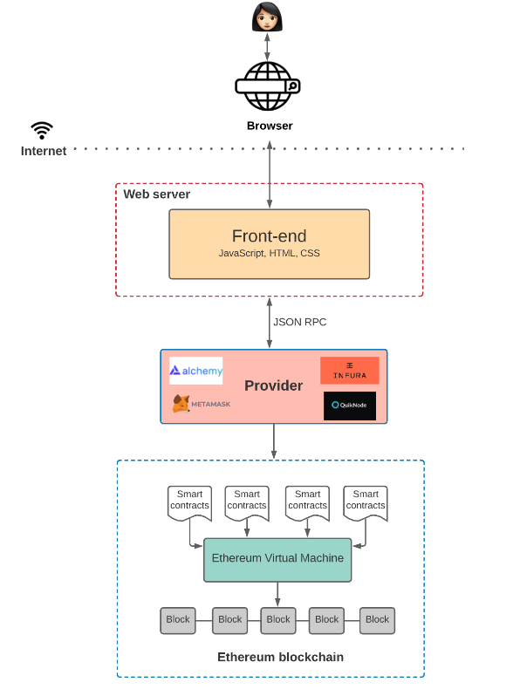
ARCHITECTURE OF THE MODEL

Slide 9
FUNCTIONAL REQUIREMENTS
Functional requirements describe the specific behaviours' and functionalities that a system must perform to meet the user’s needs.
Functional requirements of our System:
User Registration and Authentication
Wallet Integration
Token Swapping
Cross-Platform Compatibility
User Interface (UI)
Transaction History
Security Measures

Slide 10
NON-FUNCTIONAL REQUIREMENTS
Non- Functional requirements specify the qualities and characteristics that are essential for the effective operation of a system, focusing on aspects such as performance, usability, reliability and security.
Non-Functional requirements of our System:
Reliability
Security
Usability
Performance
Interoperability
Scalability

Slide 11
SOFTWARE REQUIREMENTS
Operating System - Windows, OS
Programming Language’s – Flutter, Infura and Solidity
Execution Environment – Android Studio, Visual Studio Code
Infura API Key: Required for connecting the app to the Ethereum blockchain.
Ethereum Wallet: For testing and deploying smart contracts during development.

Slide 12
HARDWARE REQUIREMENTS
RAM - 8 GB or above
Processor - Intel core i5 or above
Storage - 256 GB or above
Stable network connection
Smartphone Emulators/Devices

Slide 13
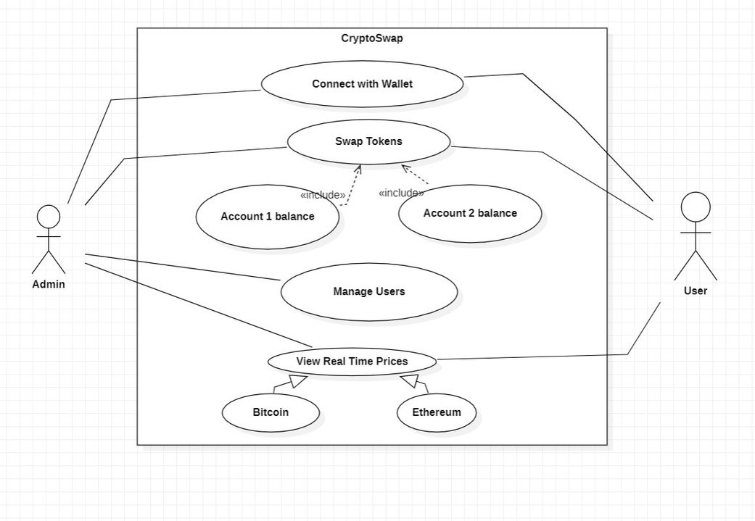
DESIGN
Use Case Diagram:

Slide 14
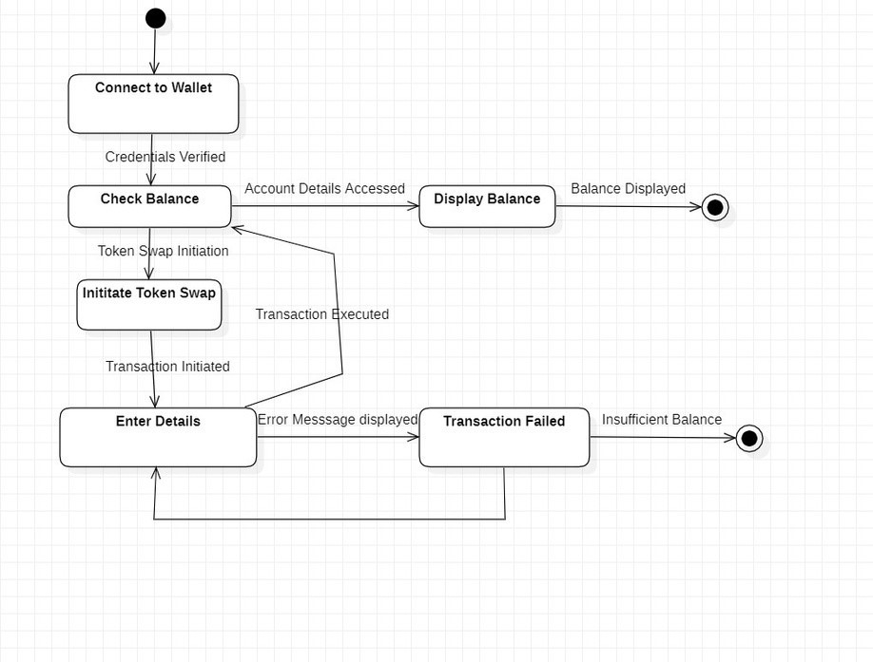
State Chart Diagram:

Slide 15
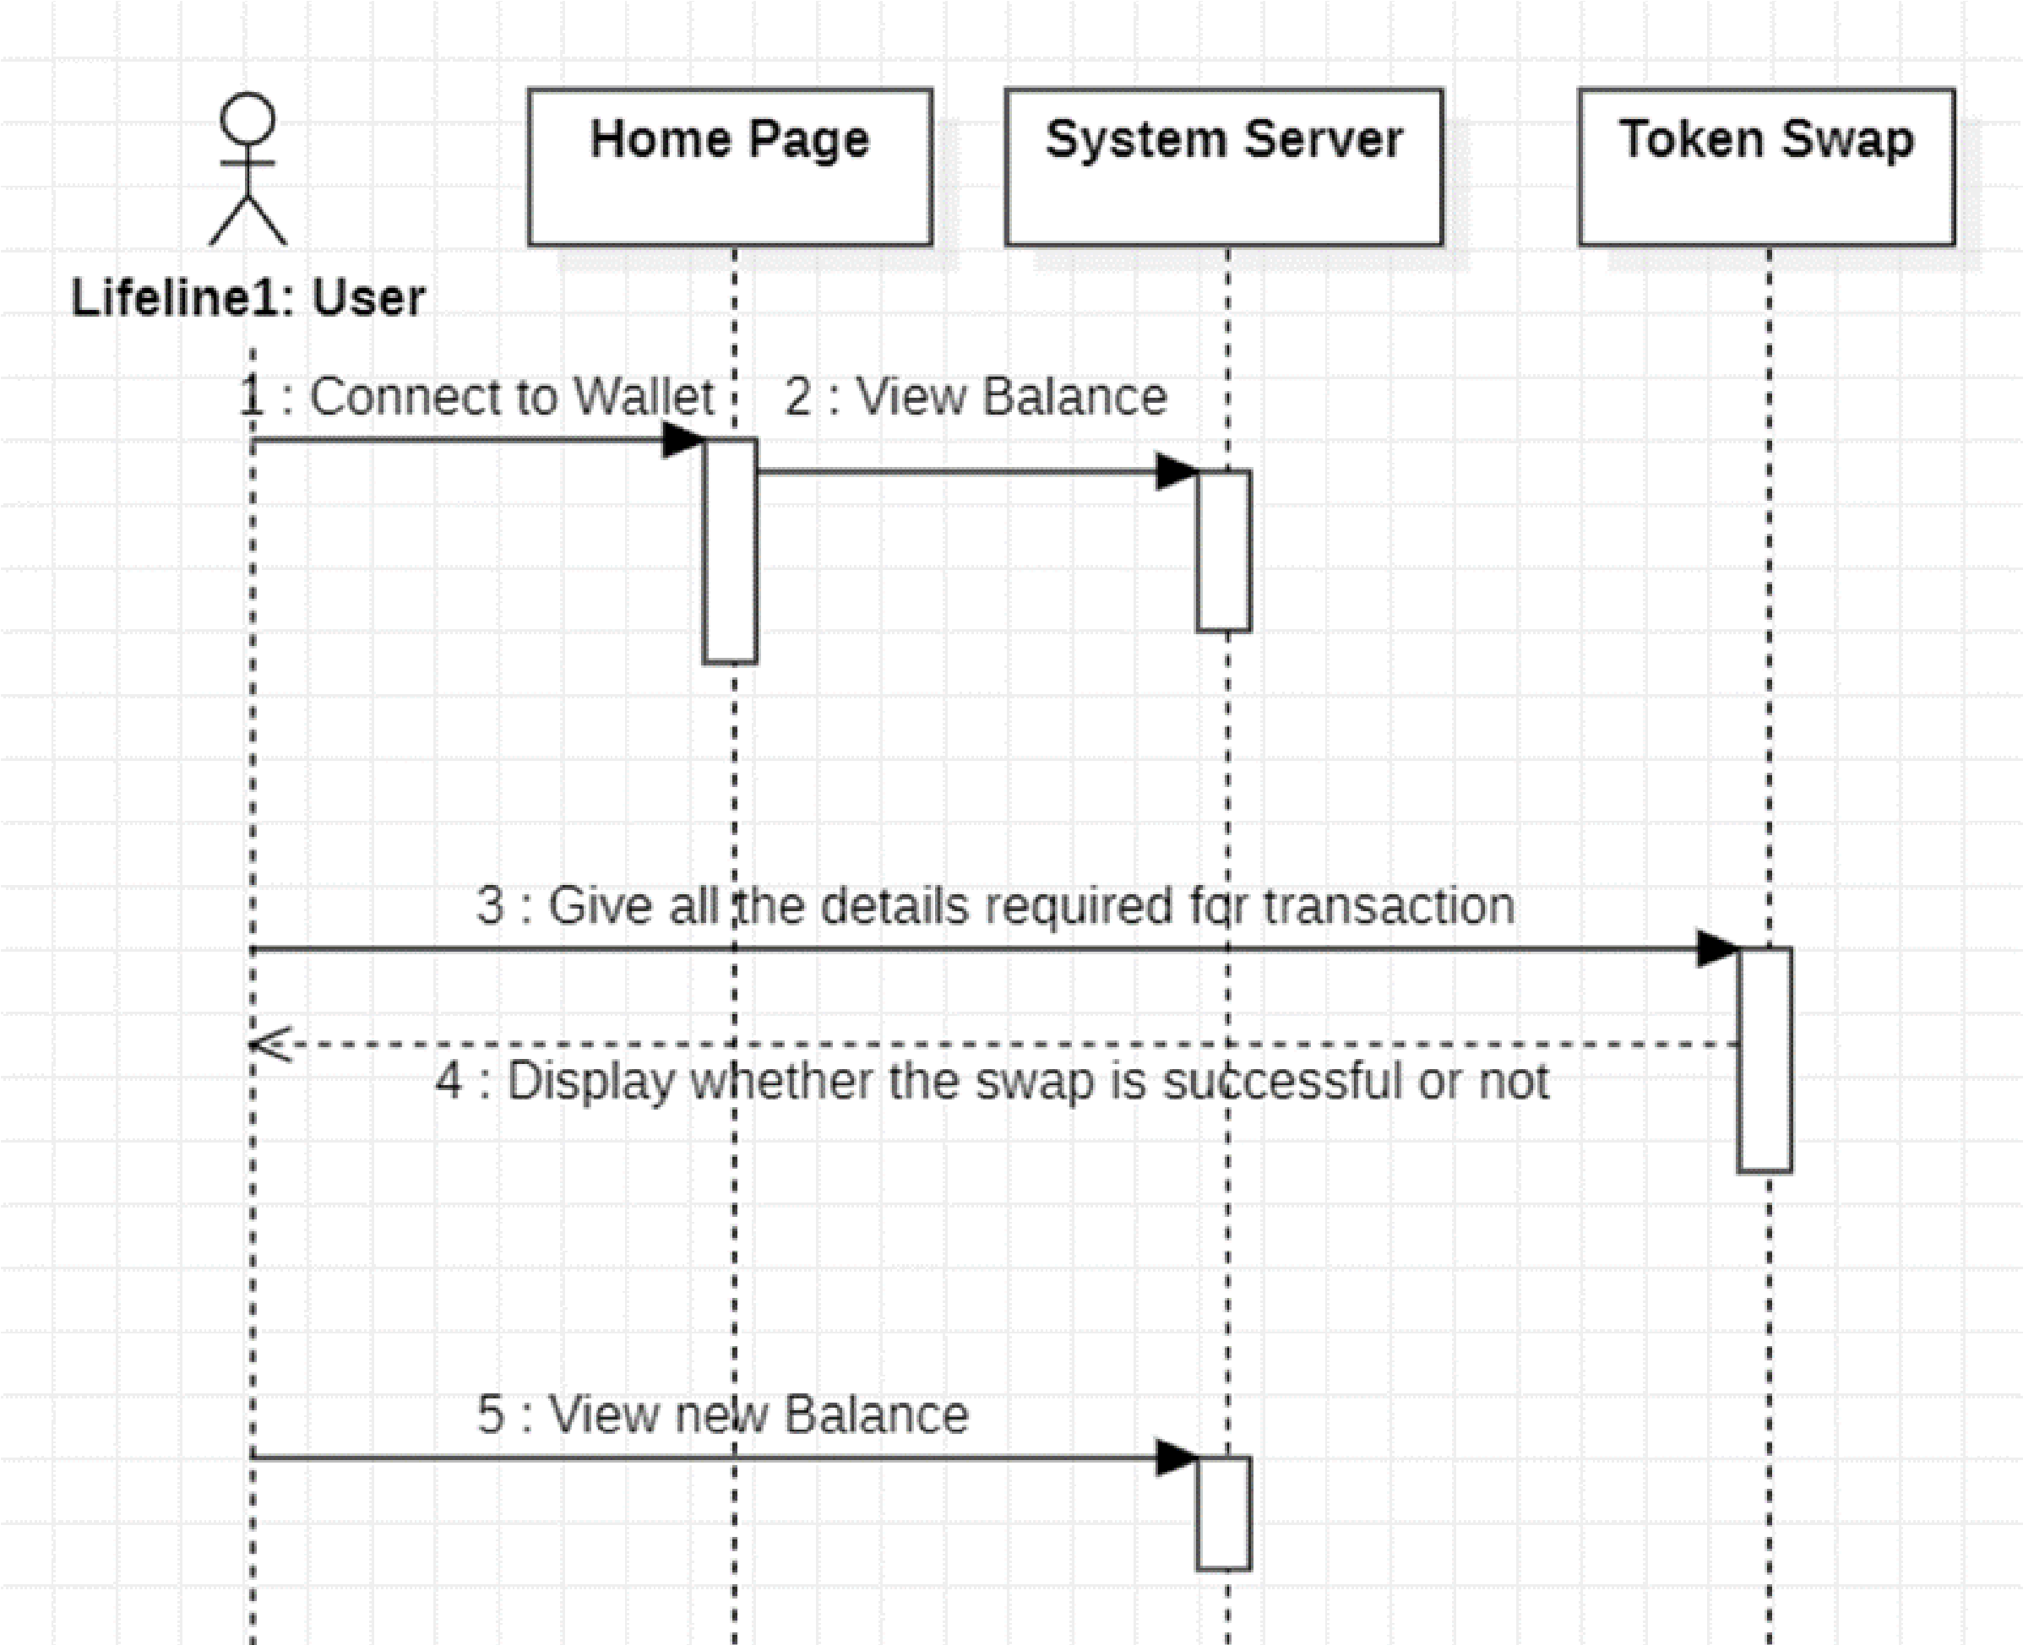
Sequence Diagram:

Slide 16
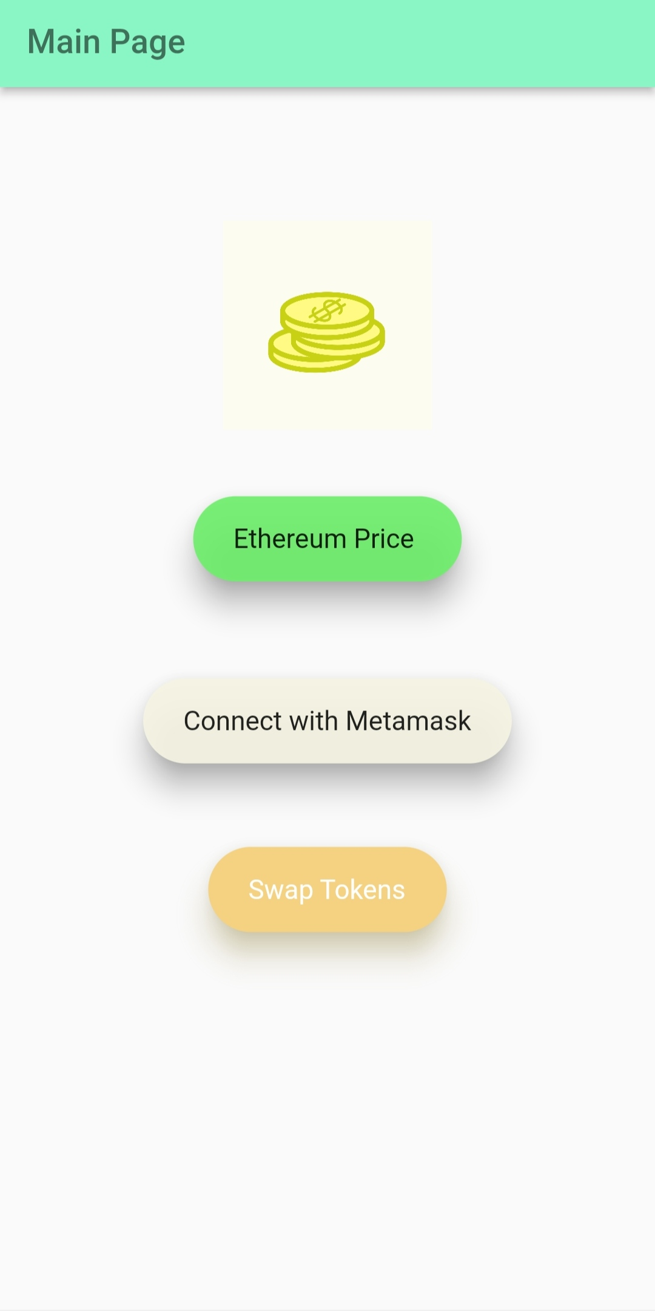
User Interface Design

Slide 17
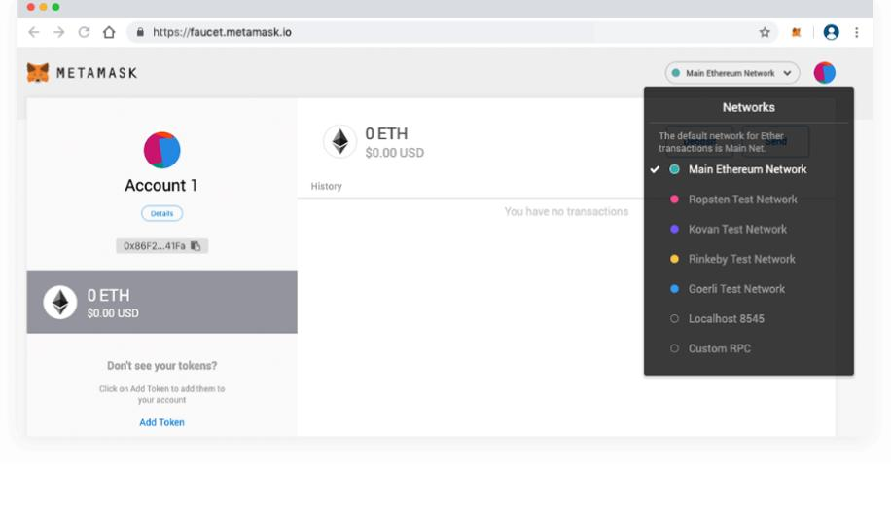
MetaMask Wallet

Slide 18
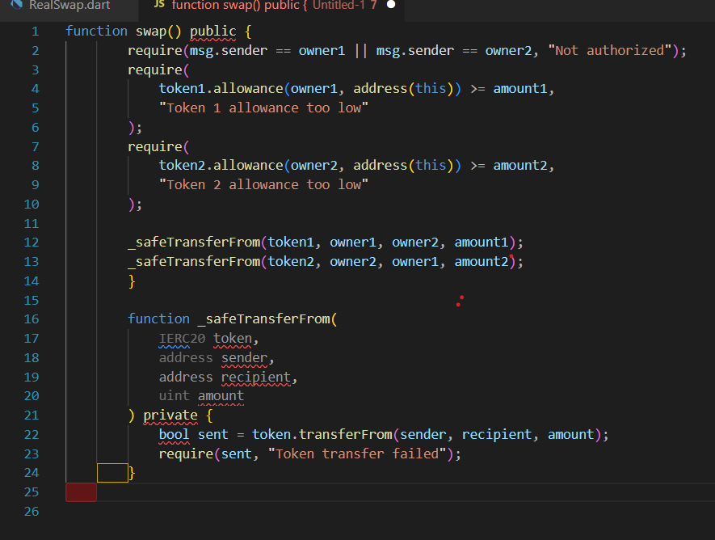
Implementation of the code
Smart Contract to Swap the Tokens :

Slide 19
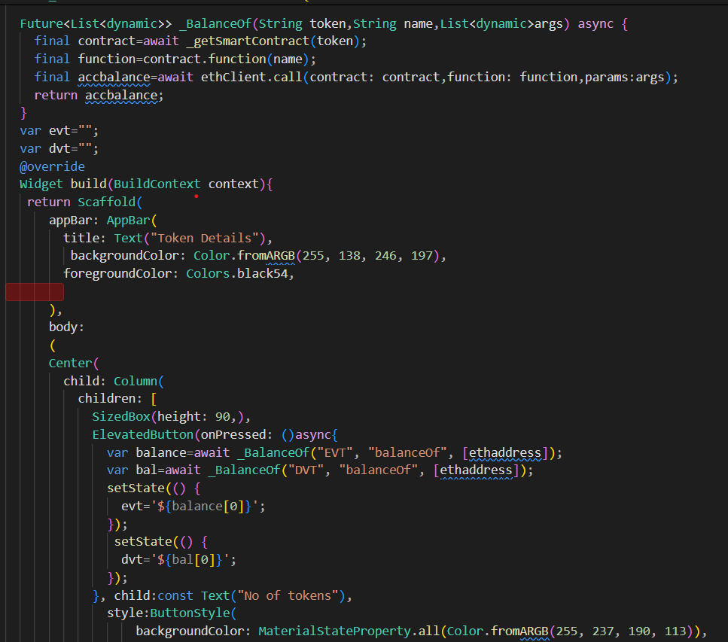
Token Balance :

Slide 20
INNOVATION IN THE PROJECT
Cross-Platform Development with Flutter
Decentralized Token Swapping
Security Measures with Smart Contracts
User-Friendly Interface and Experience
Educational Impact and Community Development
Transparent and Trustless Token Swapping

Slide 21
REFERENCES
[1] Bonneau, J., Miller, A., Clark, J., Narayanan, A., Kroll, J. A., & Felten, E. W. (2022). SoK: Research Perspectives and Challenges for Bitcoin and Cryptocurrencies. In Security and Privacy (SP), 2015 IEEE Symposium on.
[2] Ahmad, F., Malik, M. I., & Mushtaq, Q. (2021). Flutter: A New Evolution in Mobile App Development. In 2021 4th International Conference on Computing, Mathematics and Engineering Technologies (iCoMET).
[3] Griffiths, I., & Hinchcliffe, R. (2020). Flutter for Beginners: An introductory guide to building cross-platform mobile applications with Flutter and Dart 2. Packt Publishing Ltd
[4] Swan, M. (2019). Blockchain: blueprint for a new economy. O'Reilly Media, Inc.
[5] Wüst, K., & Gervais, A. (2018). Do you need a blockchain? In 2018 Crypto Valley Conference on Blockchain Technology (CVCBT).
[6] Atzei, N., Bartoletti, M., & Cimoli, T. (2017). A survey of attacks on Ethereum smart contracts (SoK). In Principles of Security and Trust (POST).

Slide 22

THANK YOU

